Slide 1
Optical Recognition of Handwritten Digits

Slide 2
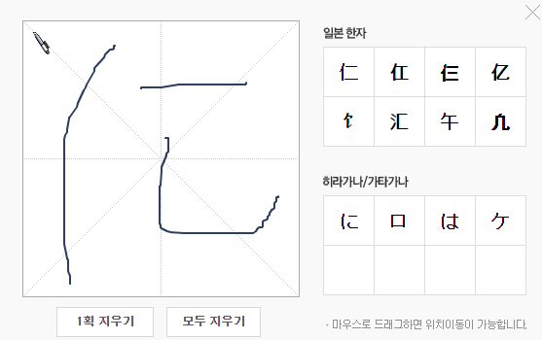
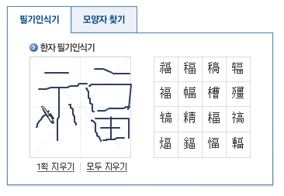
Character recognition
네이버 일본어 인식
네이버 한자 인식

Slide 3
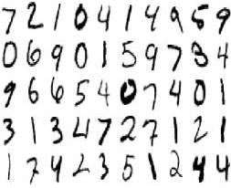
Optical Recognition of Handwritten Digits

Slide 4
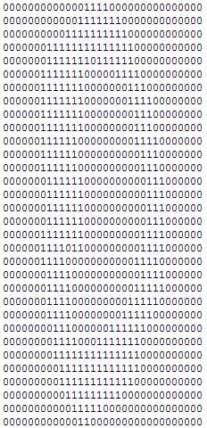
Data
32
32x32 bitmaps
Nonoverlapping blocks of 4x4 ➔ counting
32

Slide 5
Data
# of attributes : 65
All input attributes are integers in the range 0..16. The last attribute is the class code 0..9
0,1,6,15,12,1,0,0,0,7,16,6,6,10,0,0,0,8,16,2,0,11,2,0,0,5,16,3,0,5,7,0,0,7,13,3,0,8,7,0,0,4,12,0,1,13,5,0,0,0,14,9,15,9,0,0,0,0,6,14,7,1,0,0,0
Label!!
Notes:
저렇게 block으로 나누면 65개의 attribute가 생김 그래서 1이 몇 개인지 체크

Slide 6
Statistics
 | # of instances
Training | 3,823
Testing | 1,797
Class distribution

